Slide 1
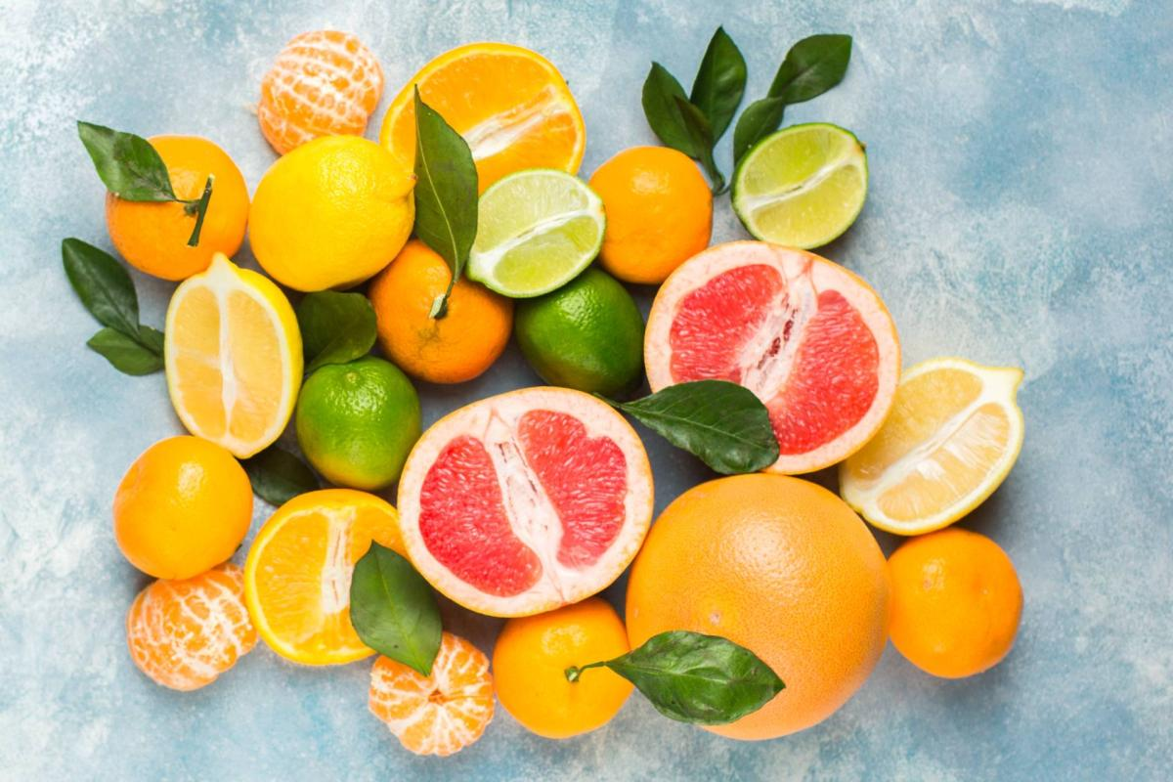
Isolation of Hespridine from orange peel
Done by
Lect. A.T. pharmacsit Nour Hameed Aldhif

Slide 2
Introduction
Hesperidin,is a secondary metabolite , a flavanone-type polyphenolic bioflavonoid, it is found abundant in the peel and membraneous parts of orange peel and other citrus fruits.. Hesperidin can also be found in green vegetables. Aglycone part of hesperidin is the flavanone hesperitin bind to the disaccharide rutinose.

Slide 3
The molecular structure of hesperidin affects its bioavailability and absorption levels Thus, the metabolism of citrus flavanones is determined by the sugar moieties and its removal degree by intestinal bacteria.

Slide 4
Beneficial Effects of Hesperidin
Effect on Cardiovascular Disease Risk Factors

Slide 5
Anticarcinogenic
Antioxidant
Anti-inflammatory
Anti-microbial
H.W.// You shouldn’t take this supplement if you’re taking certain medications, including anticoagulants, blood thinners, blood pressure drugs and calcium channel blockers.

Slide 6
Extraction methodes
Hesperidin can be isolated by two different methods :
Conventional Method: - The dried orange peels (250gm) were macerated with 800ml of methanol overnight then filter and collect the filtrate for detection the hesperdine .
Modern Method: - By using soxhlet apparatus and petroleum ether as solvent .In this lab. We use conventional method

Slide 7
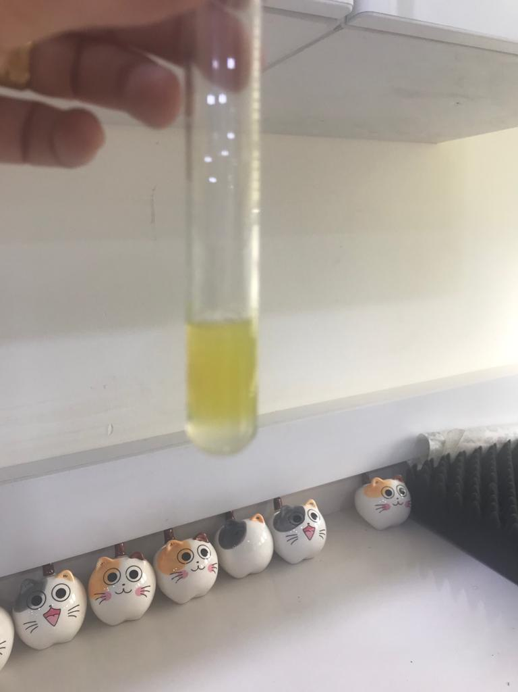
Detection of Flavonoids
FeCl3 test
1 ml of extract + few drops of FeCl3 (10%)→ Brown color
Lead acetate test
1ml of extract +10 drops of lead acetate (10%) →White color

Slide 8
Shinoda test
1 ml of extract + 5 drops of HCl + few crystal of magnesium→pink color
Sodium hydroxide test
1ml of extract +5 drops of NaOH (10%) →yellow color → disappear after addition of 5 drops of HCL

